Slide 1
EDA – Video Game Data
By Neil Aucoin
Notes:
Hey, I’m Neil and this is my project.
I decided to go with the EDA project as I was looking to learn some data visualization software and saw it as a good opportunity. I was also eager to work more with APIs and building datasets so it seemed like the way to go for me.

Slide 2
Process
Concept
Research
Databases
Software
Data Collection
Software Experimentation
Data Processing
Dashboard Design
Data Engineering
Dashboard Finalization

Slide 3
Concept
Video Game Feature Popularity and Ratings
Personal Interest
Relevance
Utility
Availability of Data
Notes:
The concept for this project was to build a dashboard that can be used to identify trends in video game releases and ratings, in order to identify patterns and for use by game developers to determine what genres, platforms, stores, tags, release dates, etc. may be best to improve chances of a successful game release.
For example, a developer looking to release a Co-op Card game could enter those as a tag and genre respectively and see what other tags and genres are most often used in association with these, the average rating these combinations of tags and genres tend to receive, what platforms and stores these types of games are best received on, and all possible release dates that would avoid other big game releases.

Slide 4
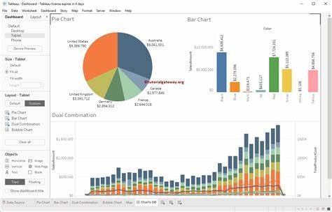
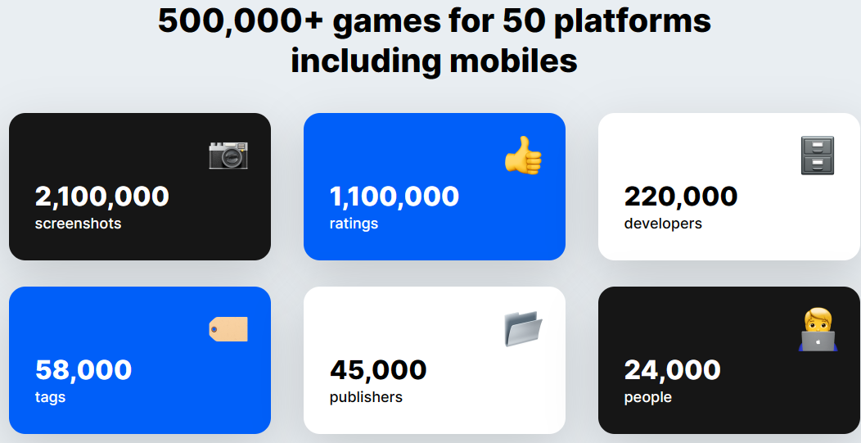
Research
Databases
IGDB
RAWG
SteamWeb
Software
Tableau
PowerBI
Google Charts
Notes:
Went with RAWG for unbiased data and simple API
Went with Tableau due to ease of use, common job requirement, and friend experience

Slide 5
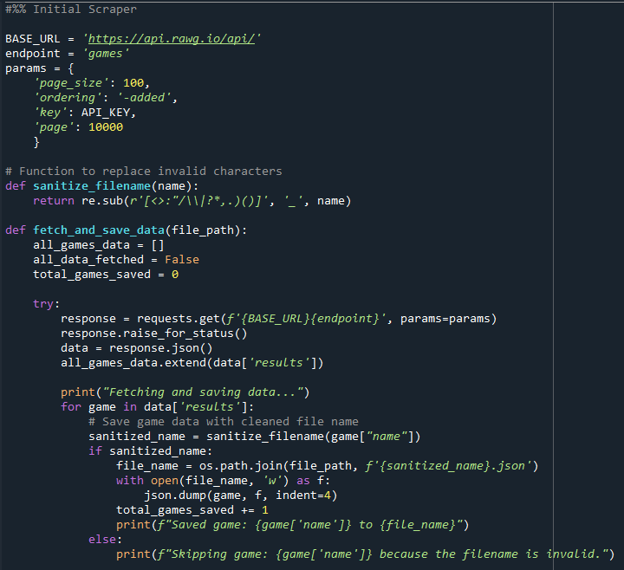
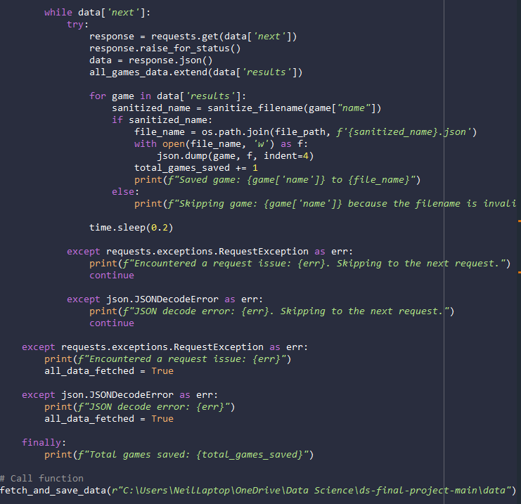
Data Collection
Notes:
Took everything from random sorting order to get unbiased data, took all data to experiment and see what I could do
- RAWG Scraper
-- Calls RAWG API to fetch game data
-- Sanitizes file names to avoid issues with saving files
-- Skips games that cause errors in order to avoid interrupting code
--- Ex: invalid file names, JSON decode errors, request issues
-- Saves each game's data as its own .json file
-- "Round 2 Scraper" functions the same but ignores games already in a given
--- data base, used for repeat passes to catch missed/skipped games

Slide 6
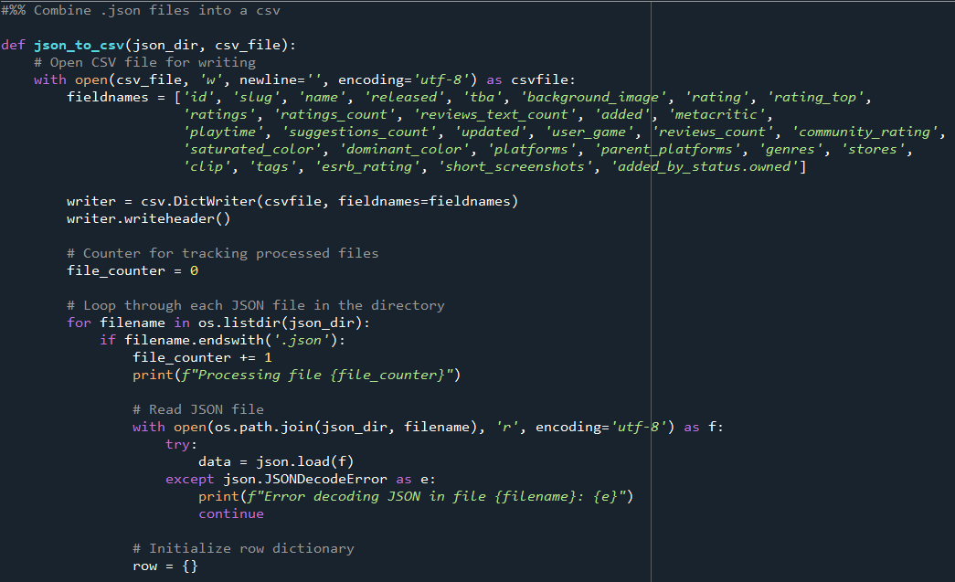
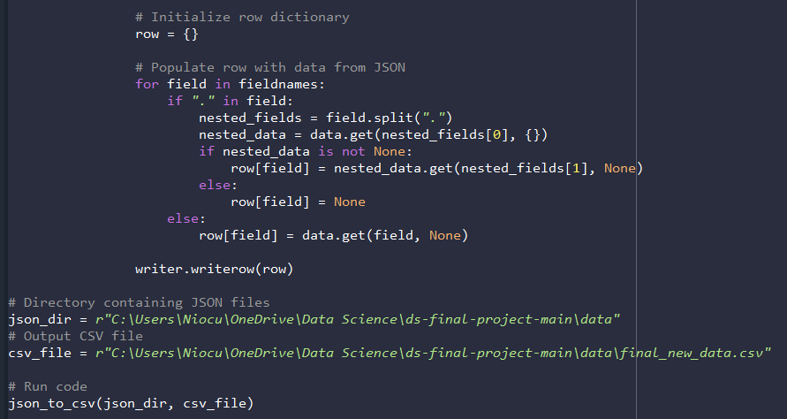
Data Collation
Notes:
Combined .json files into one csv file
- Combine Data
-- Combines json files from RAWG Scraper into one csv file
--- Skips JSON decoding errors and tracks files processed

Slide 7
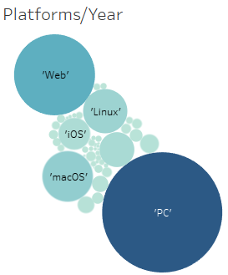
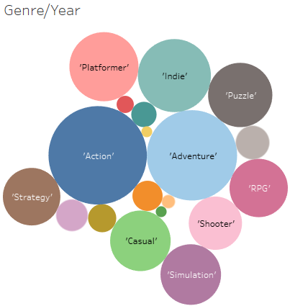
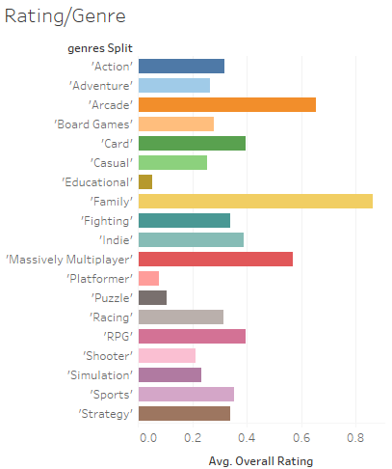
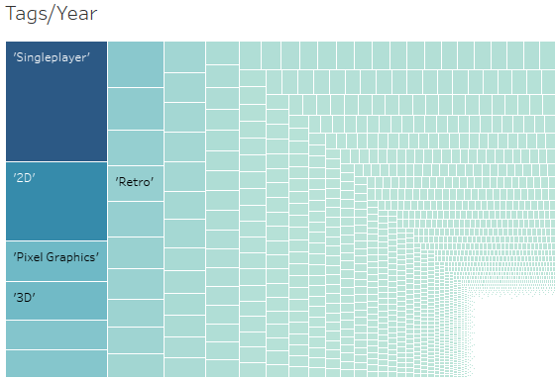
Software Experimentation
Notes:
Did tutorials, looked up videos, experimented with filters and chart types

Slide 8

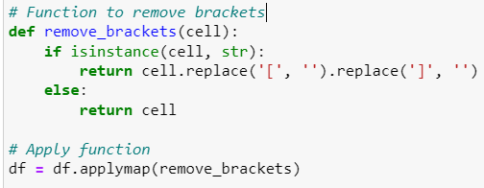

Data Processing
Notes:
Turned HTML code into dictionaries++
Then just into strings for Tableau
Drop duplicates
Remove brackets from names
Reset index for proper count
- Data Exploration and Cleaning
-- Used to get an overview of the data
-- Removed unnecessary columns
-- Cleaned up formatting of columns with multiple values
--- Changed strings to dictionaries, removed "slug:" "name:" statements
-- Created sample ratings plot to visualize data
-- Identified all unique release years, platforms, genres, stores, tags, and Ratings
--- And their counts
-- Added month and month/day columns
-- Identified and removed duplicates
-- Removed brackets from dictionaries for compatibility with Tableau
-- Reset index to have consistent unique identifiers per gamr

Slide 9
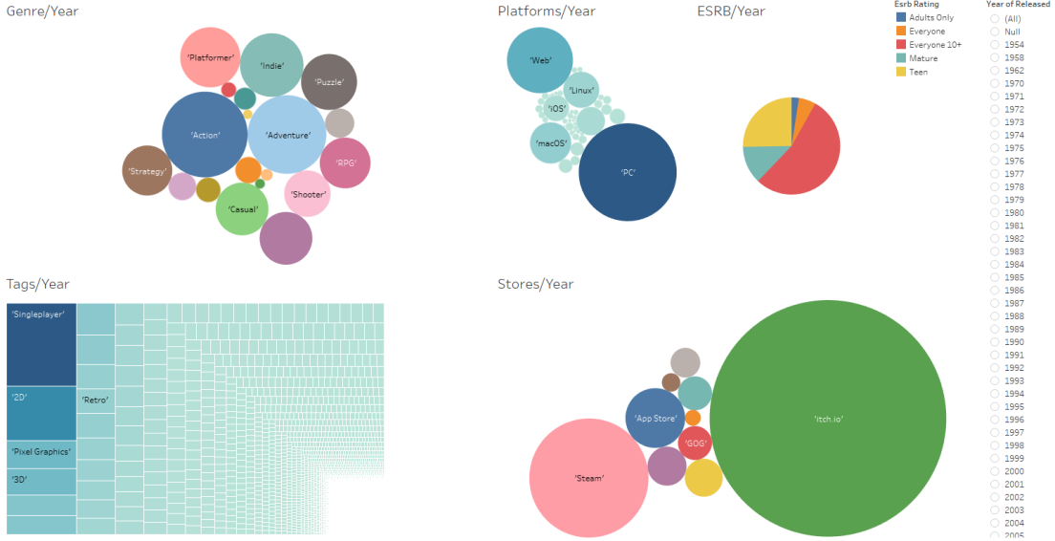
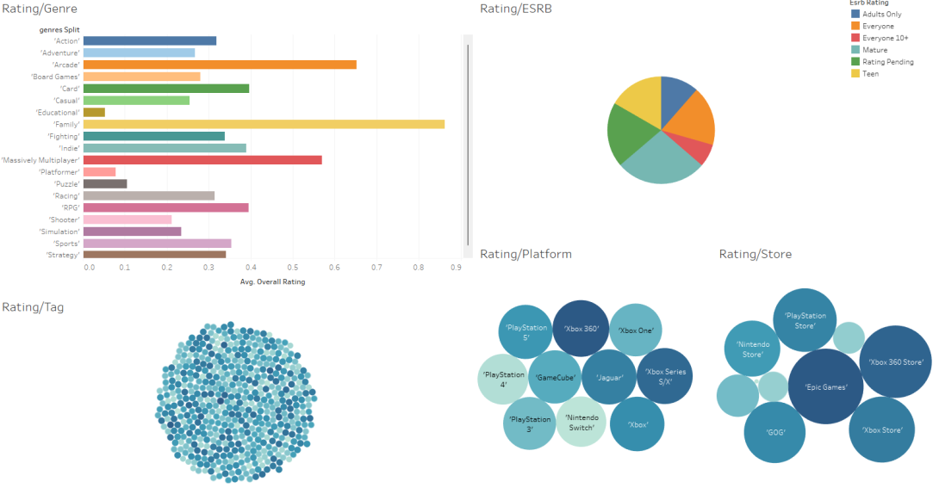
Dashboard Design
Divided into observations and projections
Most popular/Year Top rated/Factor

Slide 10
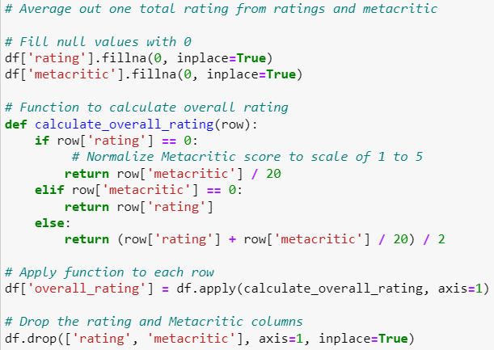
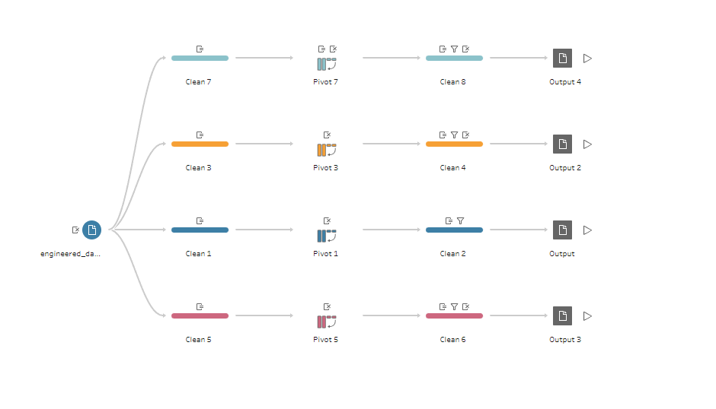
Data Engineering
Review averaging
Data Pivot
Tableau prep
Data Split
Notes:
Filtered to not take null review values (which were set to 0)
*Final dataset is split into 5 csv files
**Master dataset and splits to seperate cells containing multiple values into multiple entries for ease of use in Tableau filters
Data is taken from RAWG video game databased (unfiltered) with games from 10 different stores and 50 different platforms. Databased currently contains information from 410,107 different games.
- engineered_dataset
--* Index
--- Contains a unique identifier used to identify games and link different data files
--* Slug
--- Contains the game's name formatted for use in APIs, to be potentially used in future data collection
--* Name
--- Contains the game's title
--* Released
--- Contains the game's release date formatted as YYYY-MM-DD
--* Platforms
--- Contains the platforms the game is available on
--* Genres
--- Contains all of the game's genres
--* Stores
--- Contains the stores the game can be purchased on
--* Tags
--- Contains all tags associated with the game
--* ESRB Rating
--- Contains the game's ESRB Rating
--* Overall Rating
--- Contains the game's averaged out user score and metacritic rating
- split_tags
-- Contains all data from engineered_dataset with each game split into multiple entries (one for each tag)
- split_stores
-- Contains all data from engineered_dataset with each game split into multiple entries (one for each store)
- split_platforms
-- Contains all data from engineered_dataset with each game split into multiple entries (one for each platform)
- split_genres
-- Contains all data from engineered_dataset with each game split into multiple entries (one for each genre)

Slide 11
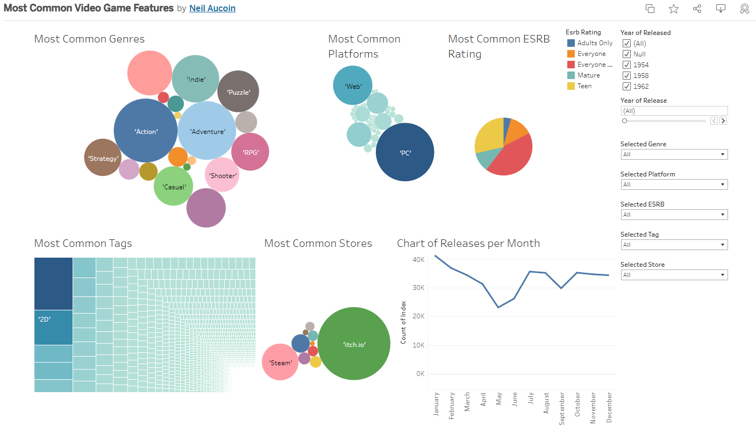
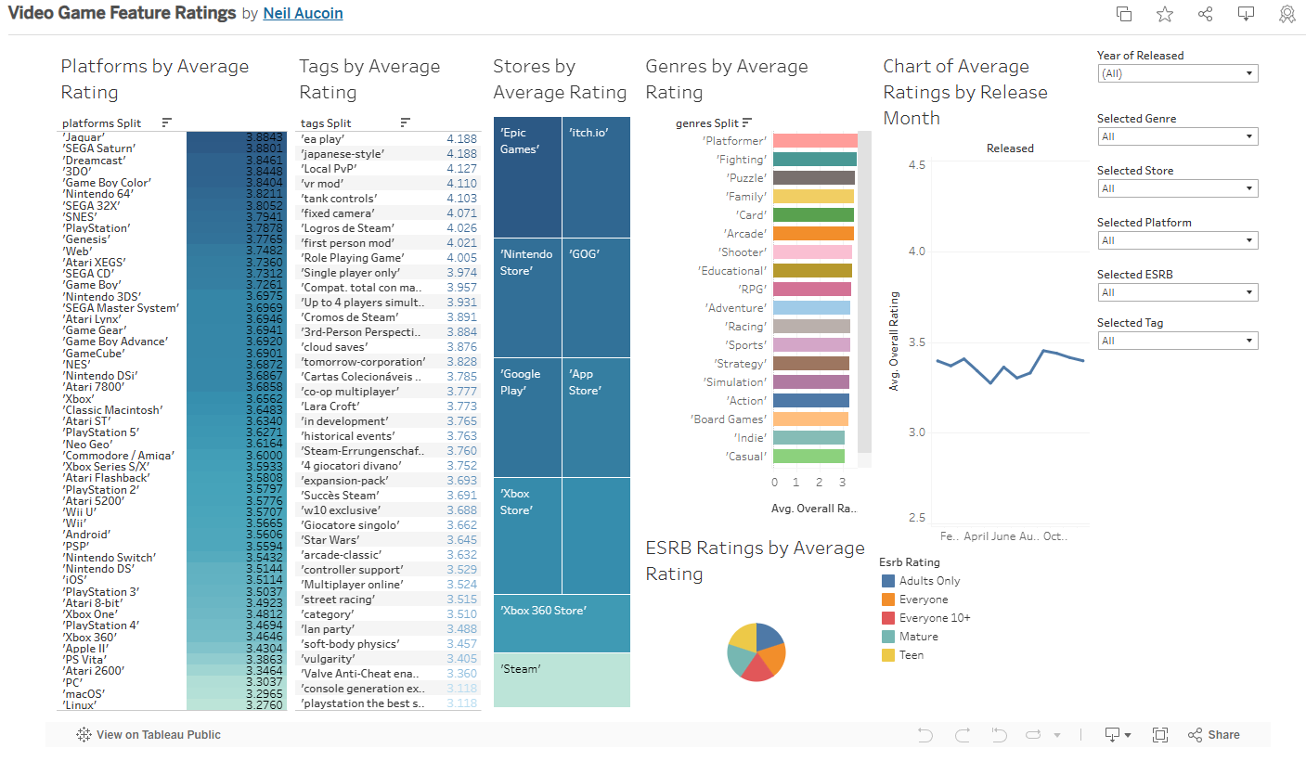
Dashboard Finalization
Notes:
*Interactivity, parameters
New visuals for clarity on ratings dashboard
Let’s check them out

